Slide 1
Project Title:
Success story - Henry Ford’s Model T
A TQM Project Review 3 Presentation

Slide 2
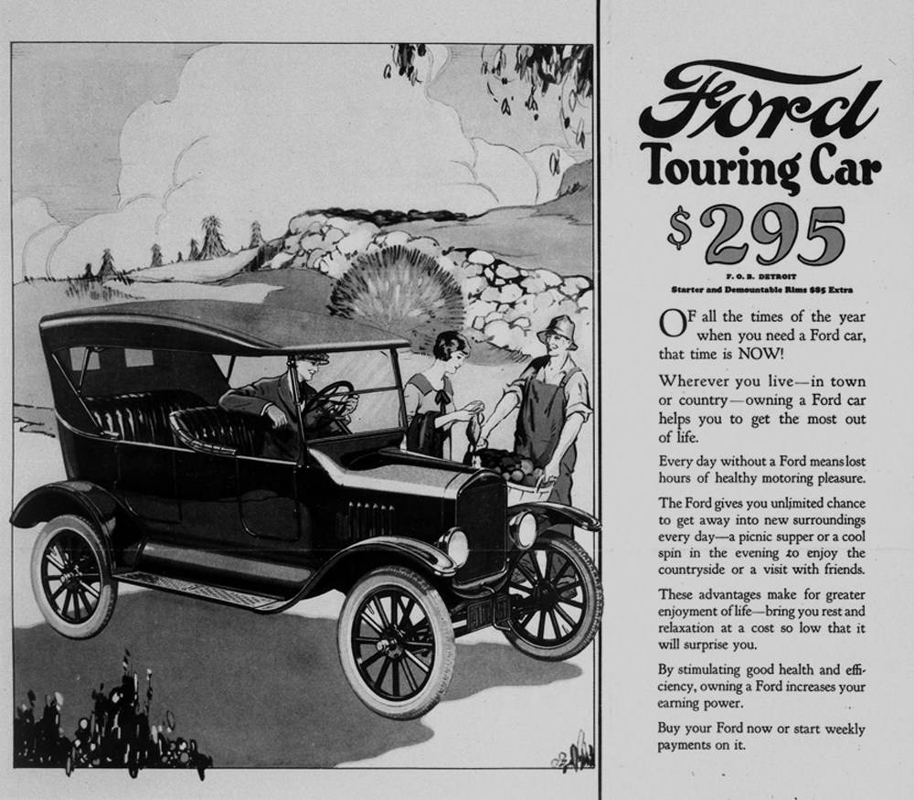
Look at the COVER FOR THE AD.
See the full ad on Model T

Slide 3
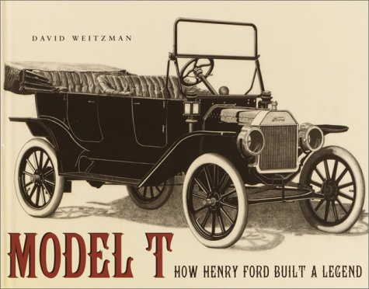
Why this project?
We thought of studying the introducer company of TQM practices. In Ford Motor Company TQM practices started in the 1980s when “Quality Is Job 1” was their slogan...When TQM was first utilized, it started through a joint venture. Back then when Ford Motor Company TQM practices were vast, that slogan made more sense. Today at Ford Motor Company, their most popular slogan is ―Ford Has a Better Idea.

Slide 4


Teammates:
Chandreyi 19MIY0031
Deepika 19MIY0013
Lokesh 19MIY0001
Prasanna 19MIY0024
Sneka 19MIY0019

Slide 5
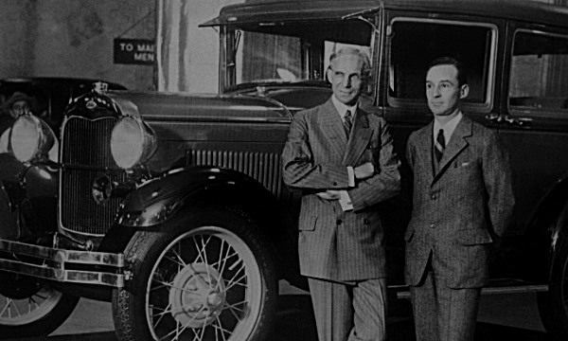
"You can have it in any color you want, as long as it is black."
In this project, we will be deciphering his breakthrough cost cutting decisions like going for only black color made available.

Slide 6
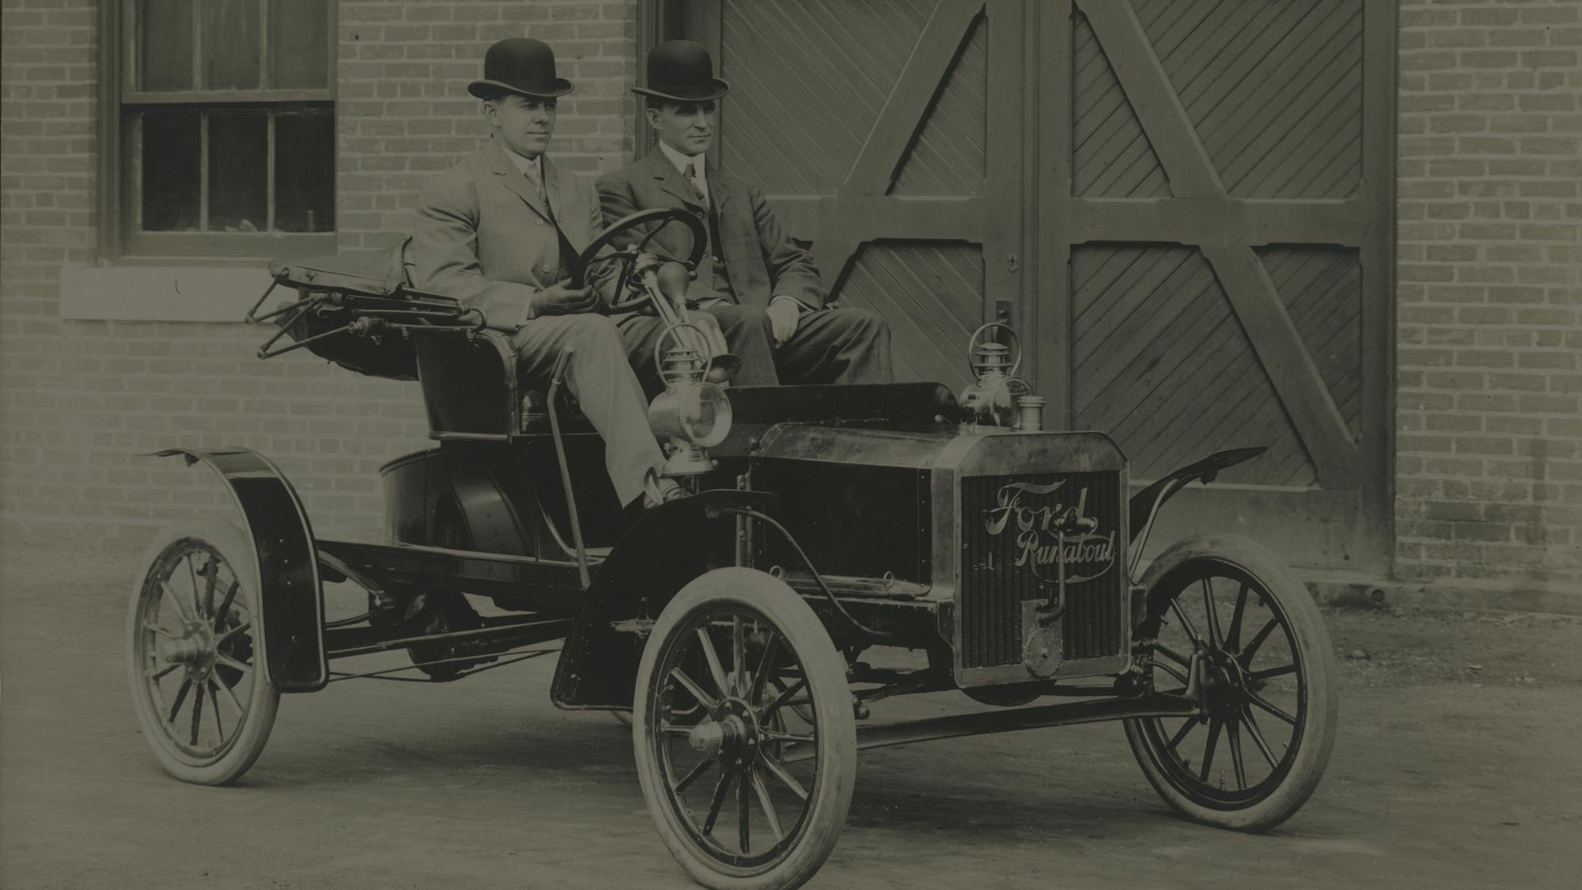
Project objective
In here we are to review different ideas pertaining to the performance of Henry Ford’s Model T to be affordable, simple to operate, and durable. The vehicle was one of the first mass production vehicles, allowing Ford to achieve his aim of manufacturing the universal car. We know that the vehicle had many new features that were unique for its time. The low price point allowed many people to become a Ford owner, should they choose it, and caused Ford Motor Company to be a household name.
See a short video on it’s test drive

Slide 7
Ford’s other famous sayings
Quality means doing it right when no one is looking.
I will build a car for the great multitude.
If I had asked people what they wanted, they would have said faster horses.

Slide 8
Let’s start with the Literature Review.

Slide 9
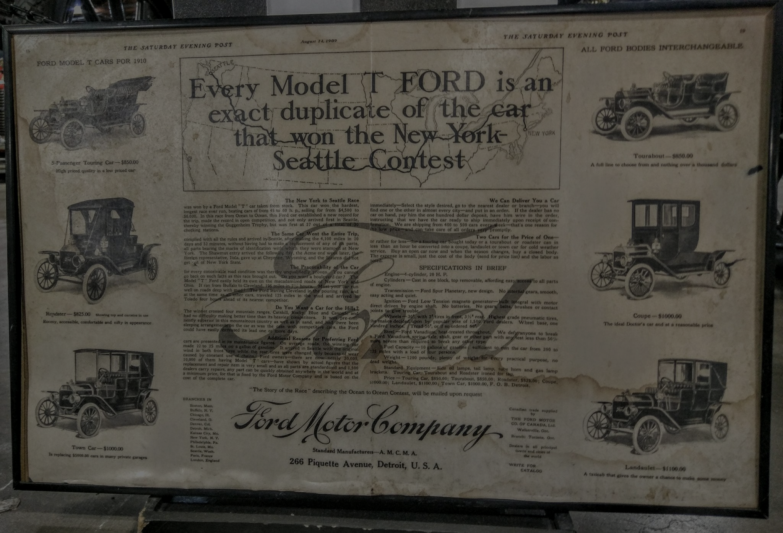
In October 1908, Ford launched the Model T. At the very beginning, the Model T was a success for its general utility, fine performance and price.
This car rapidly became the first car owned by many in the country. Early versions of this car were refined and offered very basic features: no speedometer, no starter, no temperature gauge, and no bum-pers.

Slide 10
The Model T’s owners were seduced by the fact that it was easy to drive, repair, and modify while also being affordable. The vanadium alloys used by ford to build this car was a significant advantage in terms of quality.
The Model T was produced from October 1908 to May 1927 for an overall production of 15 million .

Slide 11
The Model T was also available in several different colours. The Model T was often referred to as the ‘universal car’, because it was extended to every type of customer and could be used for every situation.

Slide 12
Note:
Twenty years ago, when an invasion of Japanese imports threatened the American automobile industry, the Ford Motor Company led a quality revival based on the management philosophy of W. Edwards Deming, who was controversial then and is out of fashion now. The results of the movement, known as Total Quality Management, were stunning at Ford. After racking up $3 billion in losses between 1979 and 1982, Ford hit a series of home runs, including the aerodynamic Taurus-Sable cars, and by 1986 had become the most profitable American auto company.
Now, though, Ford's hard-won reputation for quality is being tarnished by a series of setbacks, from the controversy over deadly rollovers of Ford Explorers.

Slide 13
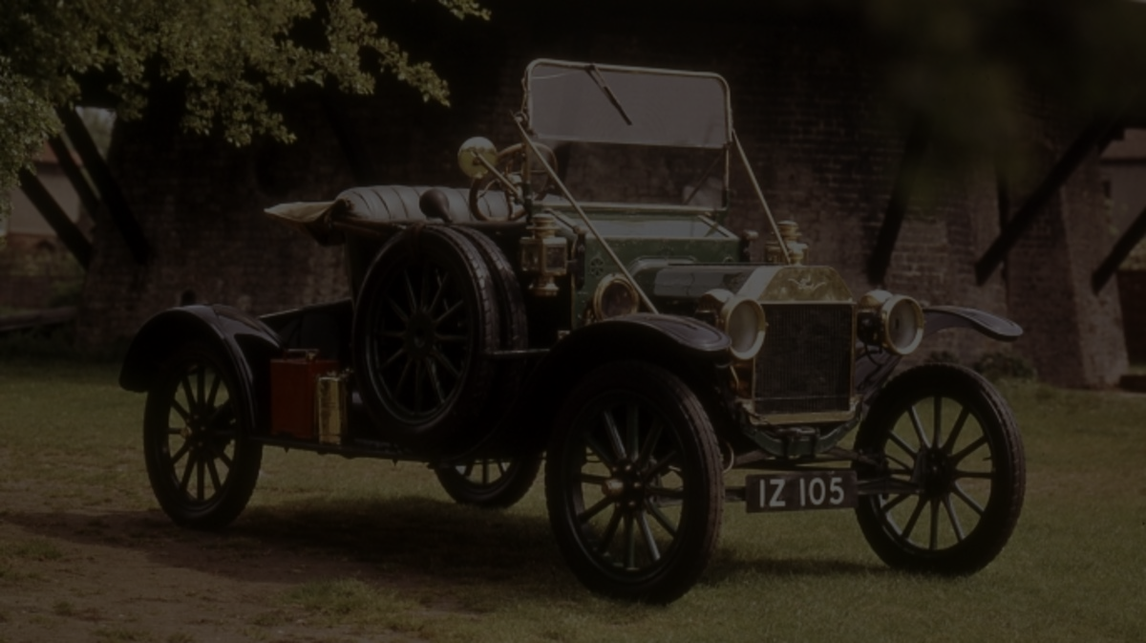
Here are some wise words by wise people on and around the vehicle.

Slide 14

Hedrick Smith:
“Henry Ford gave that idea popular currency when he brought out the famous Model T car and announced in 1914 that he would pay his workers the then unheard-of wage of $ 5 a day. Not only was it a matter of social justice, Ford later wrote, but it was smart business. When wages are low, Ford argued, business and the economy are at risk. But when pay is high and steady, Ford reasoned, business is more secure because workers earn enough to be good customers and eventually to be able to afford to buy Model Ts.“
Hedrick Smith is a Pulitzer Prize-winning former New York Times reporter and Emmy award-winning producer and correspondent.

Slide 15
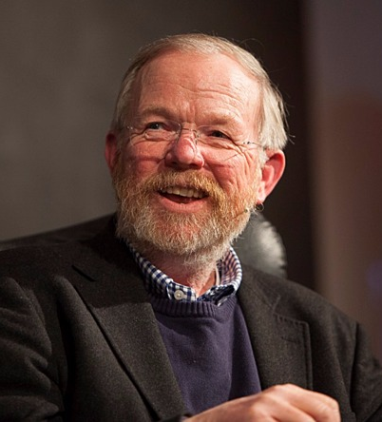
Bill Bryson:
“One central characteristic of the Model T now generally forgotten is that it was the first car of consequence to put the driver's seat on the left-hand side. Previously, nearly all manufacturers placed the driver on the outer, curb-side of the car so that an alighting driver could step out onto a grassy verge or dry sidewalk rather than into the mud of an unpaved road. Ford reasoned that this convenience might be better appreciated by the lady of the house, and so arranged seating for her benefit. The arrangement also gave the driver a better view down the road, and made it easier for passing drivers to stop and have a conversation out facing windows. Ford was no great thinker, but he did understand human nature. Such, in any case, was the popularity of Ford's seating plan for the Model T that it soon became the standard adopted by all cars.”
William McGuire Bryson (born 8 December 1951) is an American–British author of books on travel, the English language, science, and other nonfiction topics.

Slide 16

Simon Dudley:
“Then, a historic event changed everything for my family: Henry Ford created the Model T. Others soon followed suit, inventing their own automobiles. The people who had been buying and renting carts started buying trucks or small cars instead. Despite my family's expertise in their craft, nobody wanted a car with wooden wheels. Very quickly, within the space of 10 years, their business started to collapse.“
Simon is the former leader of Royal Borough of Windsor and Maidenhead Council where he served from 2007 to 2019.

Slide 17
Hence,
The Model T is the car that’s credited with "putting the world on wheels.” It was a huge success due to the TQM techniques used in its production that made it the Car of the Century.

Slide 18
Understanding the problem and methodology.

Slide 19
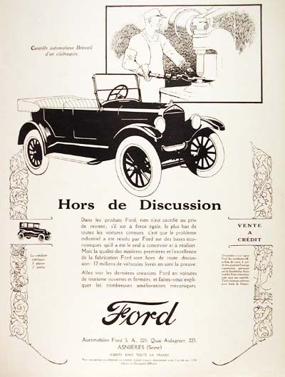
Complicated problems look easy when solved using Divide and Conquer approach!
WE WILL APPROACH THE PROBLEM BY
DIVIDING IT INTO 3 SUBDIVISIONS

Slide 20
Block Diagram
Problem 1
Problem 2
Problem 3
What we want to get from this Project ? To list out the factors and decisions that led to the revolution. And try to reason those decisions using TQM.
How are we Planning to Approch ?
Studying Literature survey and gathering Data set and perform Tests and Analysis.
How will this Create impact in the society ? By making an easy to understand report that can be used further by TQM practitioners.

Slide 21
Timeline Plan Sheet
September
November
October
December
Literature Survey, Data Collection and Research
Combining all our Inferences into a single Report
REVIEW 1 |  |  |  | REVIEW 2 |  |  |  |  |  |  |  |  | REVIEW 3
Dividing up work amongst ourselves and preparing Analysis Reports individually
Final Presentation submission

Slide 22
Let’s see the Progress till date.

Slide 23
We have gathered relevant research papers, from different sources, on our topic like: ‘Henry Ford Vs Assembly Line Balancing by James M. Wilson from Adam Smith Business School in UK’ and twelve others, which we will be using as reference while bringing out insights on the success of Ford Model T.
We have provided the links and short descriptions to all those reserch papers being used.

Slide 24
Chosen Research Papers:
James M, Wilson “Henry Ford vs. Assembly Line Balancing” (February 2014) International Journal of Production. This analysis shows Ford’s assembly line was used differently than modern ones and their production systems were more flexible than previously recognized. It will be shown that Ford used multiple lines flexibly to cope with large monthly variations in sales. Although a line may be optimized to yield the lowest cost production, systems composed of several parallel lines may yield low cost production along with output and product flexibility.
Fabrice Alizon, Steven B. Shooter, Timothy W. Simpson “Henry Ford and the Model T: Lessons for Product Platforming and Mass Customization” (July 13, 2009) ASME 2008 International Design Engineering Technical Conferences and Computers and Information in Engineering Conference. In this paper, they study Ford’s Model T in depth and describe insights into Ford’s vision and his car: how the platform was built, how it was leveraged, and how the platform was maintained dynamically and with continuous improvements to maximize learning and economies of scale. Finally, they compared Ford’s approach to more current approaches to learn from his innovative product line.

Slide 25
Chosen Research Papers:
Ken Starkey, Alan McKinlay “Beyond Fordism? Strategic choice and labour relations in Ford UK” (June 1989) New industrial competition has led major automobile manufacturers to re-analyse their approaches to business strategy and industrial relations. This article examines attempts at Ford Motor Co. to adopt its traditional approach to work organization to its changing business environment.
Thompson, Steven James “Improving the performance of Six Sigma : a case study of the Six Sigma process at Ford Motor Company” (2007) University of Bedfordshire. This thesis concerns the question, "Why is the performance of Six Sigma within The Ford Motor Company below that experienced in other companies, and what can be done to improve it?“ This thesis aims to make recommendations that would improve the performance of Six Sigma within the Ford Motor Company.

Slide 26
Chosen Research Papers:
Stefan Gies, Sven Faßbender, Micha Lesemann, Bastian Hartmann “Concept car development with the example of a Ford model T successor” (June 2009) Acoustics, Speech, and Signal Processing Newsletter, IEEE 111(6):44-51 This thesis develops an innovative vehicle concept which is capable of carrying conventional as well as alternative drivetrain modules thanks to its scalable design — a modern “Tin Lizzy” with the basic sales price of less than 7000 US dollars.
Richard Zarbo, Richard Zarbo, Rita D'Angelo “Transforming to a Quality Culture: The Henry Ford Production” (Deember 2006) Pathology Patterns Reviews 126 They describe the cultural transformation of the surgical pathology laboratory at Henry Ford Hospital, Detroit, MI, to one that has adopted an expectation for empowered workers to see their daily work in the context of continually learning and making effective process improvements that are designed and tested by the scientific method. This transformation has been achieved by creating an organizational and educational framework for implementing guiding principles originally systematized as the basis of lean manufacturing by our founder, Henry Ford, at the turn of the century, and incorporating the innovations of the Toyota Production System.

Slide 27
Chosen Research Papers:
Rita D'Angelo, Richard J Zarbo. “The Henry Ford Production System: measures of process defects and waste in surgical pathology as a basis for quality improvement initiatives” (Sept 2007) National library of medicine. They implemented a continuous quality improvement initiative in pursuit of a "zero-defects" performance goal in surgical pathology that required design of novel data collection tools to assess their current condition and sources of defects and waste. They found that through deep and honest exposure and the concerted effort of all workers, they could identify numerous sources of waste in their processes.
James M. Wilson. ”Henry Ford′s just-in-time system” (Dec 1995) International Journal of Operations & Production Management 15(12):59-75 This thesis states that Henry Ford′s ideas and practices show many features seen in contemporary Japanese approaches. Ford, in the period from 1908 through the late 1920s, relied on a number of progressive and radical methods in manufacturing management; methods that were similar to the current Japanese methods.

Slide 28
Chosen Research Papers:
Edward A. Torrero. “Automating the production line: Henry Ford began it all when he designed the first car assembly line in 1914” (Nov 1977) IEEE Spectrum 14 The automatic production line is a production system that automatically completes all or part of the manufacturing process of the product by a work-piece transfer system and a control system, which is a combination of a set of automatic machine tools and auxiliary equipment in a process sequence, referred to as an automatic line. This thesis aims to achieve the concept of the same.
John Ladbrook. “The Role of Process Simulation within Ford Six Sigma” (Jan 2010) Ford was one of the first companies to adopt and witness simulation to help develop effective manufacturing facilities, and they have also invested significantly in the Six Sigma Breakthrough Methodology. Hence its roles and impacts were presented.
James Foreman-Peck. “Technological Mutations and Henry Ford” (Jan 2006) Focussing primarily on Europe, this paper examines the evolution of the production technology associated with Henry Ford. Key elements identified are mass and flow production, the progress of which are traced from the early nineteenth century. The concentration of standardised demand, necessary for mechanisation and therefore mass production, was in war-related production and often in state industry.

Slide 29
Chosen Research Papers:
György Gyurecz, Trent Boggess. “A Technical Examination of the Planetary Transmission of the Ford Model T” (Oct 2008) Conference: Ford T 2008 During the 19 year long production of Ford T-Model, its transmission remained unchanged. The transmission, designed by Joseph Galamb, and his team adopting Henry Ford’s ideas, was developed for slightly more than a year, in a secret office. What was this transmission like? This article brings it closer to current admirers through its history, and gives an analysis of it for those, with engineering aspect of view.
Robert A. Laird, Thomas N. Sherratt. “The economics of evolution: Henry Ford and the Model T” (Dec 2009) Wiley online library For the past 30 years evolutionary biologists have used a fictional tale about engineer and businessman Henry Ford to help illustrate the undesirability of over-design. Thus, on discovering that kingpins were rarely damaged in scrapped Model T automobiles, Henry Ford is alleged to have concluded that the kingpins were unnecessarily durable and asked that they be built to a cheaper specification. The general lesson that has been drawn from this tale is that natural selection will act to equalize the mortality risks accruing from damage to each part of the organism's body. This paper argues the validity of the tale.

Slide 30
We had all divided these papers amongst ourselves to read, understand and summarise the information to each other, so that we can collectively discuss its contents and decide on furthur progress.
We have had a small discussion and brainstorming session amongs ourselves, where we exchanged our understandings and opinions on each of the papers.

Slide 31
The Research Gap we encountered while going through all these research papers was that: the strategies used by “the father of mass production” – Henry Ford, is not summarized and contrasted with the current TQM practices used in several companies, although many papers have claimed his decisions to resonate Japanese principles. We aim to do the same in this project taking references from several research papers.

Slide 32
Results and discussion

Slide 33
Henry Ford did not invent the automobile or the assembly line. Instead, he was the most successful at marrying these two technologies together in ways that increased efficiency and reduced costs. Let’s see his ideas and decisions that can be related to the currently practiced TQM principles:

Slide 34
PAPER CONCEPT | ITS LINK TO TQM
Automating the Production Line | One of the main principles of TQM is making a tightly knit integrated system of processes. Automating the Production Line for the first time systematized the working span of every staff. This could be called the first step towards achieving integrity.
New Industrial Competition that made Ford re-analyse their Work Environment | As work environment directly impacts employee performance, and employee involvement is a critical tool to achieve continuous improvement in companies, this major change in Ford Motor Co. can be credited to be one of the basic steps towards the bigger goal.

Slide 35
PAPER CONCEPT | ITS LINK TO TQM
Assembly line: used differently, more flexible, multiple parallel lines | Ford used multiple lines flexibly to cope with large monthly variations in sales. Although a line may be optimized to yield the lowest cost production, systems composed of several parallel lines may yield low cost production along with output and product flexibility. A flexible product design will reduce redesign costs and allow quicker response to customers with increased performance. So satisfying customers was one of his priorities. Which in turn is also a TQM goal.
Innovative Product Line and Platform | Product innovation is important because it can help one create new spaces in a seemingly crowded market. By identifying the gaps and imposing oneself into a new space, one can find an audience and satisfy consumer needs in a way that is new and refreshing. Ford Model T was the first of its kind that gave Ford its name and customer base.

Slide 36
PAPER CONCEPT | ITS LINK TO TQM
Evolution of Production Technology in Mass and Flow | Henry Ford’s contributions offer valuable lessons for Product Platforming and Mass Customization. Product platforming is a specific approach to new product development utilizing common technology components or subsystems deployed across multiple products or product lines which has been argued to bring numerous valuable organizational outcomes and cost reduction. Both these factors being a concern in TQM, we can credit his decisions to have been following a similar path.
Undesirability of over-design => Kipkings were rarely damaged in scrapped Model Ts’ | To reduce the cost of his vehicle, Ford drew attention to the fact that Kipkings (a part of the Model T) were more durable than required and ordered them to be made of cheaper specifications that would allow all the parts of the vehicle to wear out at a similar rate. He did not want to spend on something that would not be optimally used off by his customers. This proves that he had foreseen the undesirability of over design that early in time. This decision definitely contributed to the success of the Model T.

Slide 37
PAPER CONCEPT | ITS LINK TO TQM
Experiment in the pursuit of “Zero Defect” system => numerous sources of wastes could be identified with the collective effort of all the workforce | Through the collective effort of the workforce, a zero defect system could be achieved in Ford Motor Company. This resonates to the TQM practice of Employee Involvement in every stage of processes and projects. It is only through transparency and a rapid flow of open communication and ideas between employees and executives, that wastes can be identified and reduced.
Comparison with Japanese Practices and Ideology | He had an integrated systems approach founded on a market strategy allied to a focused manufacturing system that emphasized quality, efficient production and an avoidance of waste; within a paternalistic framework intended to make the best use of a generally low grade but highly varied workforce. These on being compared to Japanese practices did align together even though they were introduced independently. Just like many TQM practices align with Japanese ideology.

Slide 38
Now let’s see why Ford Model-T was a big success:
Its SPECIFICATIONS
Inline 4 cylinder engine with 20 horsepower.
10 gallon fuel tank (you need to guess how far you’ve gone assuming 20 miles are covered per gallon).
Maximum speed was 45 miles/ hour which might sound so slow but it was a lot faster than a horse and buggy (with average speed of 5 to 8 miles/ hour) which was the common mode of transport back then.
Made for rough terrain.

Slide 39
All these specifications might sound to be a joke today as we have vehicles which run at 180 kmph. But at that time people could never even think of travelling at that speed and more over even owning a car! It didn’t bother then if they had to carry an extra set of blankets for the comfort they were getting was unimaginable. Ford could produce it at such a mass scale and in such a low cost only because of his techniques and choices of production.

Slide 40
WHAT WAS EXCLUDED? | WHAT WAS INCLUDED?
No heating | A car! And not a horse and buggy!
No air conditioning | All terrain capability
No gas gauge, and other luxuries. | At a great price.

Slide 41
Conclusion

Slide 42
We discussed Ford’s work and the Model T. This very successful car (the longest and perhaps most successful car ever realized), was not only available in a black model, but represented a product line of vehicles characterized by significant variety. Variety within the product line (average of five different products each year), variety also through 5000 gadgets offered by the Ford Company; and variety finally with thousands of specific Model Ts tailored to final customers’ needs.

Slide 43
The Model T platform was significant, including the entire underbody, the engine, etc., and improved over time along with the car bodies. The platform was independent from the bodies used to customize it. Interfaces were common for the entire product family, permitting easy manufacturing mixing and late differentiation. A version of mass customization was also implemented by Ford. In fact, Ford’s company built the common platform and used specialized manufacturers to tailor the Model Ts to the exact customers’ needs.

Slide 44
Industries with manufactured products can learn from Henry Ford’s success. Ford’s experience was forgotten in the past industry designing non-platform product even when some product lines had sufficient homogeneity to be build on a product platform. Current practices will benefit from the Model T on numerous aspects from lifecycle management to mass customization via platform design and management. Future work will target the study of points highlighted in the discussion section, especially the detail of the platform specification and the resulting family of products.

Slide 45
In the process we also discovered and discussed Ford Motor Company’s current backlogs in management and presented a revised process map that can be used to improve the production capability in the company.

Slide 46
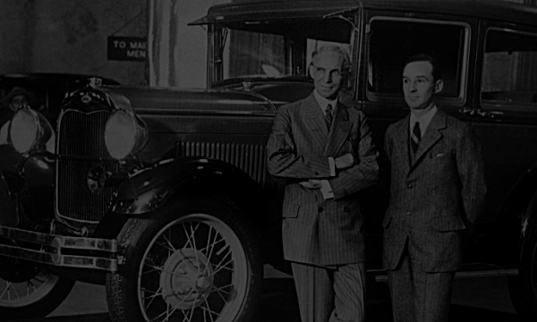
Thank you.

Slide 47
All Referred Papers:
James Wilson, 2014,” Henry Ford vs assembly line balancing”, International journal of Production.
Fabrice Alizon Steven B Shooter, Timothy W Simpson,2009,” Henry Ford and the model T; Lesson for Product Platforming and Mass Customization.
Ken Starkley, Alan Mckinlay,1980,” Beyond Fordism? Strategic choice and labour relations in ford UK.
Thompson, Steven James,2007,”Improving the performance of six sigma: a case study of the six sigma process at ford motor company.
Stefan Geis, Sven Fabender, Micha Lesemann, Bastial Hartman,2009,” Concept car development with the example of a Ford model T successor.
Richard Zarbo, Rita D’Angelo,2006,” Transforming to a quality culture, The Henry ford production”.
Richard Zarbo, Rita D’Angelo,2007, “The Henry ford production system: measures of process defects and waste in surgical pathology as a basis for quality improvement initiatives.
James M Wilson, 1995, “Henry Ford’s just-in-time-system”.
Edward A. Torrero, 1914, “Automating the production line, Henry Ford began it all when he designed the first car assembly line.
John ladbrook, 2010,’’The role of process simulation within ford six sigma.
James Foreman-peck, 2006, Technological Mutations & Henry Ford.
Gyorgy Gyurecz, Trent Boggess, 2008, A Technical examination of planetary transmission of the ford model T.
Robert A, Laird Thomas N Sherratt, 2009,” The economics of evolution: Henry ford and the Model T.
Aldakhilallah, K.A. and Parente, D.H. 2002. Redesigning a square peg: Total quality management performance appraisals. Total Quality Management. Vol.13. No.1. Pp.39-51
Antony, J. and Banuelas, R. 2002. Key ingredients for the effective implementation of Six Sigma program. Measuring Business Excellence. Vol. 6. No. 4. Pp.20-27.
Argyris, C. and Schon, D.A. 1974. Theory in Practice: Increasing Professional Effectiveness, reprinted in 1992 by Jossey-Bass Classics Ashby, W.R. 1964. An Introduction to Cybernetics. London: Methuen
Banuelas, R. and Antony, J. 2004. Six Sigma or design for Six Sigma? The TQM Magazine. Vol. 16, No. 4. 2004. Pp.250-263.
Barney, M. and McCarty, T. 2003. The New Six Sigma: A Leader’s Guide to Achieving Rapid Business Improvement and Sustainable Results. Prentice hall. New Jersey.
Basu, R. and Wright, J.N. 2003. Quality beyond Six Sigma. Butterworth Heinemann, Oxford.
Bhote, K.R. and Bhote, A.K. 2000. World Class Quality: Using Design of Experiments to make it Happen. Amacom. Second Edition.
Breyfogle, F.W. 1999. Implementing Six Sigma: Smarter Solutions Using Statistical methods. John Wiley & Sons, Inc. New York.
Breyfogle, F.W. and Meadows, B. 2001. The Six Sigma Implementation Process. Society for Automotive Engineers
Breyfogle, F.W. 2003. Implementing Six Sigma: Smarter Solutions Using Statistical methods. Second Edition. John Wiley & Sons Inc. New York
Bryman, A. 1989. Research Methods and Organisation Studies. Routledge. London Burnes, B. and James, H. 1995. Culture, Cognitive Dissonance and the Management of Change.

Slide 48
All Referred Papers:
International Journal of Operations and Production Management. Vol. 15. No. 8. Pp.14-33
Burnes, B. 2000. Managing Change: A Strategic Approach to Organisational Dynamics. Financial Times Prentice Hall.
Capon, N., Kaye, M. and Wood, M. 1995. Measuring the success of a TQM programme. International Journal of Quality and Reliability. August 1995. Vol. 12. No. 8. Pp.8-15
Carnegie Mellon University: Software Engineering Institute. 1995. The Capability Maturity Model: Guidelines for Improving the Software Process. Addision-Wesley. Massachusetts.
Cassell, C. and Symon, G (Ed.). 1994. Qualitative Methods in Organisational Research: A Practical Guide. Sage Publications. London
Caudron, S. 1993. How HR drives TQM. Personnel Journal. August 1993. Chattell, A. 1995. Managing the Future, Macmillan Business. London.
Chen, I.J., Paetsch, K.A. and Pualraj, A. 1997. Quality manager involvement and quality performance. International Journal of Operations and Production Management. Vol.17. No.4. Pp.399-412
Clark, L. 1994. The Essence of Change. Prentice-Hall. London
Arndt, S. W. and Kierzkowski, H., 2001, Fragmentation: New Production Patterns in the World Economy.
Clymer, F., 1955, Henry's Wonderful Model T, Bonanza Books,
Fahnestock, M., 1921, The Model T - Ford Owner, Lincoln.
Ford Motor Company, 1921, Model T - Ford Service Bulletin.
Ericsson, A. and Erixon, G., 1999, Controlling Design Variant. Modular Product Platforms
Alison, F., Shooter, S. B. and Simpson, T. W., 2006, "Assessing and Improving Commonality and Diversity within a Product
Kimberly, W., 1999, "Back to the future," Automotive Engineer,
Simpson, T. W., 2004, "Product Platform Design and engineering.
Customization: Status and Promise," Artificial Intelligence for Engineering Design, Analysis & Manufacturing.
Wilhelm, B., 1997, "Platform and Modular Concepts at Volkswagen - Their Effect on the Assembly Process”.
Bremmer, R., 1999, "Cutting-Edge Platforms," Financial Times Automotive World Planning.
Beynon, H,1987, Working For Ford (2nd edition), interesting Penguin,
Friedman, H. and Meredeen, S, 1980, The Dynamics of Industrial Conflict, Croom Helm,
Abernathy, W.J, Clark, K. B. and Kantrow, A. M, 1981, The New Industrial Competition', Harvard Business Review,
Bhaskar, K., 1979, The Future of the UK Motor Indus try, Kogan Page.

Slide 49
Other References:
https://corporate.ford.com/articles/history/the-model-t.html
https://www.scribd.com/doc/90050370/TQM-IN-FORD#download
https://www.greatsayings.net/sayings-about-model-t-ford
https://www.thoughtco.com/henry-ford-quotes-1991147
https://www.greatsayings.net/sayings-about-model-t-ford
http://oplaunch.com/blog/2015/04/30/the-truth-about-any-color-so-long-as-it-is-black
https://www.brighthubpm.com/methods-strategies/72279-tqm-and-ford-motor-company

